Slide 1
SQL Server Database Transaction Log Full Demo
Problem, Symptoms, and Solutions

Slide 2
Agenda
• What is a SQL Server transaction log
• Problem scenario: Log full or almost full
• Symptoms and errors
• Root cause
• Solutions and best practices

Slide 3
Problem Scenario
• Database in FULL recovery model
• Small transaction log file
• Large transaction started
• Transaction left open (no COMMIT or ROLLBACK)
• No log truncation possible

Slide 4
Symptoms
• Transaction log keeps growing
• DBCC SQLPERF(LOGSPACE) shows log near 100%
• Log backups do NOT reduce log usage
• New transactions start failing

Slide 5
Common Error Message
• The transaction log for database is full
• Reason: ACTIVE_TRANSACTION
• Applications may stop working
• Blocking and performance issues increase

Slide 6
Root Cause
• Active or long-running transaction
• SQL Server must keep log records
• Log backups cannot truncate active log records
• Often caused by ETL jobs or uncommitted sessions

Slide 7
Solution – Correct Approach
• Identify open transaction (DBCC OPENTRAN)
• Commit or rollback the transaction
• Take a log backup
• Monitor log usage proactively

Slide 8
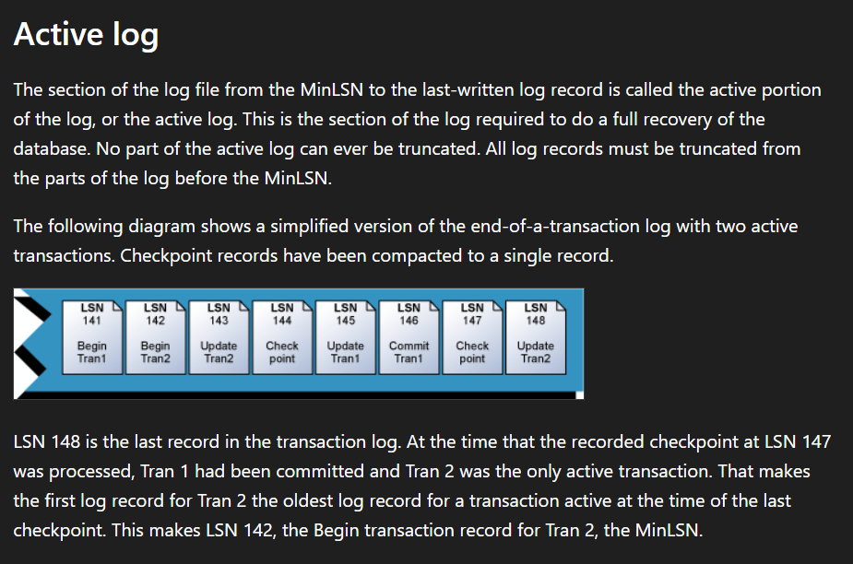
Solution – Correct Approach
SQL Server Transaction Log Architecture and Management Guide - SQL Server | Microsoft Learn

Slide 9
Emergency Option (Use with Caution)
• Switch recovery model to SIMPLE
• This truncates the log immediately
• Breaks the log backup chain
• Only use in critical emergencies

Slide 10
Best Practices
• Proper transaction design
• Frequent log backups
• Avoid long-running open transactions
• Size log files correctly

Slide 11
Microsoft SQL Server Log File Design
• Official Microsoft guidance
• Transaction log architecture and sizing
• Recovery model behavior
• SQL Server Transaction Log Architecture and Management Guide - SQL Server | Microsoft Learn

